Slide 1
Visual Components
Library Development
Transfer System 1 (TS1 & TS1 Evo)
21.10.2024

Slide 2
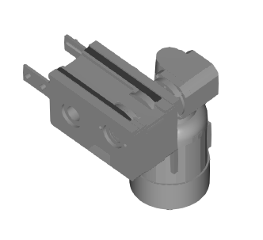
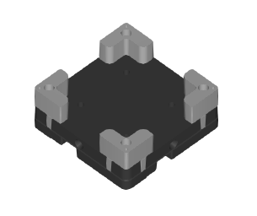
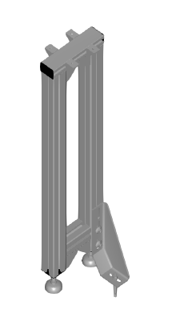
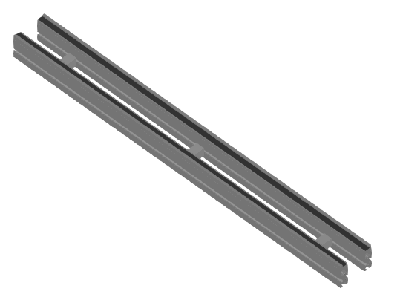
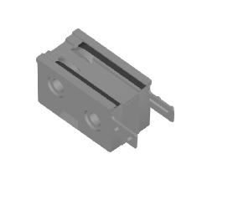
Current Progress
TS1 Library Development
Evaluation
Section ST1
Drive AS1
Return Unit UM1
Workpiece Unit
Leg Sets
Lift Position Unit
Position Unit
Conveyor Unit
Transverse Conveyor
Stop Gates
Curves
Belt Section
Planning
Workpiece Unit
Drive AS1
Specifications
Modelling
Testing
Leg Set SZ1
Release
Next…
Return Unit UM1
Section ST 1
TS1 evo development

Slide 3
Development Plan
TS1 Library in Visual Components
Product Evaluation: Go through the product catalogue and MTpro library and talk to the product manager to learn more about Transfer System 1.
Planning: Create a development plan and list the relevant TS1 components to model for Visual Components library development.
Specifications: Create an Excel sheet for listing the TS1 properties for Visual Components with the help of MTpro properties, TS2 VC library (for reference)and product catalogue.
Component Modelling: Model the TS1 components in the Visual Components.(Using TS2 library as a reference)
Component Testing: Check if all parameters and limitations are correctly implemented in the modelled components, and the same will be documented using the Excel sheet.
Demonstrator Models: Creating some basic simulation models in Visual Components to check functionality for all modelled TS1 components.
Validation Testing: Validating the TS1 library by creating the real-world use case simulation model.
Documentation: Documenting development process by making some PPT, excel sheets, screenshots and simulation videos.

Slide 4
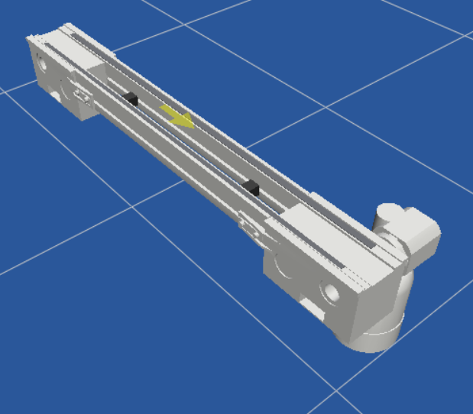
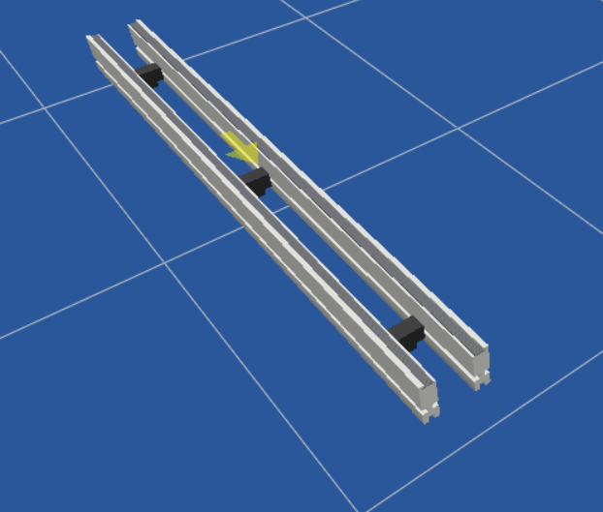
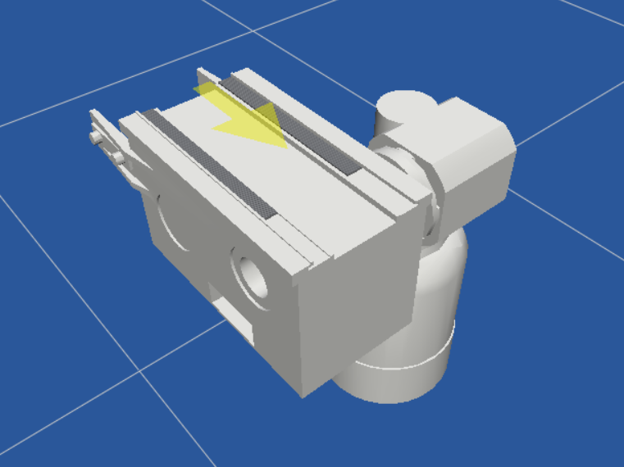
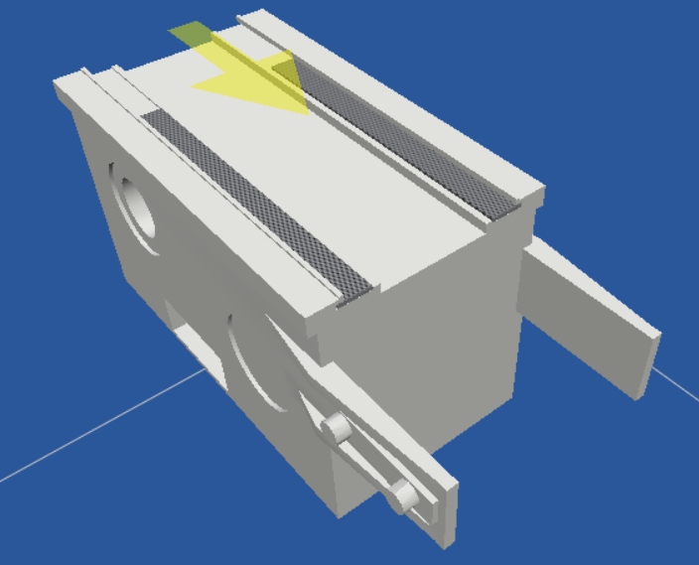
Planned Components from MTpro
Product Evaluation & Planning
Conveyor Unit
Section ST 1
Drive AS 1
Return Unit UM1

Slide 5
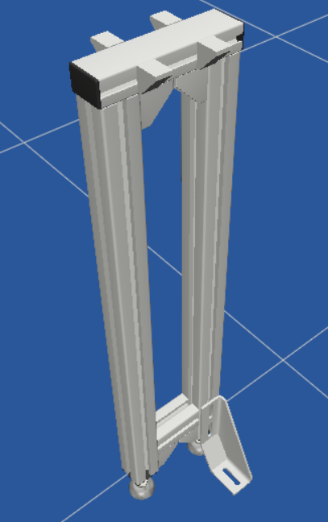
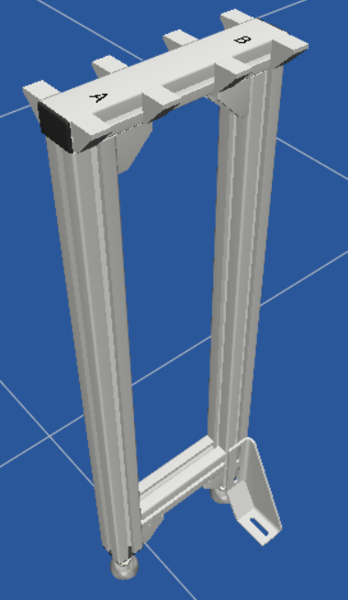
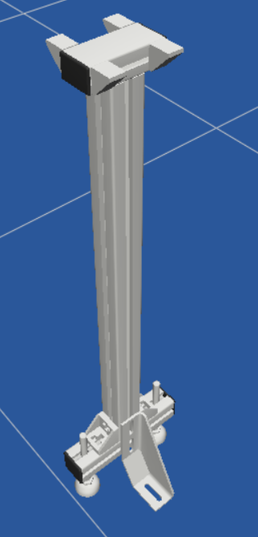
Planned Components from MTpro
Product Evaluation & Planning
SZ 1
SZ 1(two tracks)
SZ 1/L

Slide 6
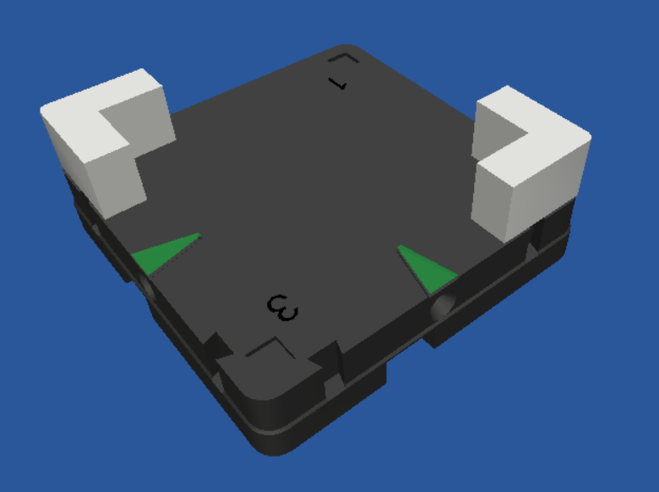
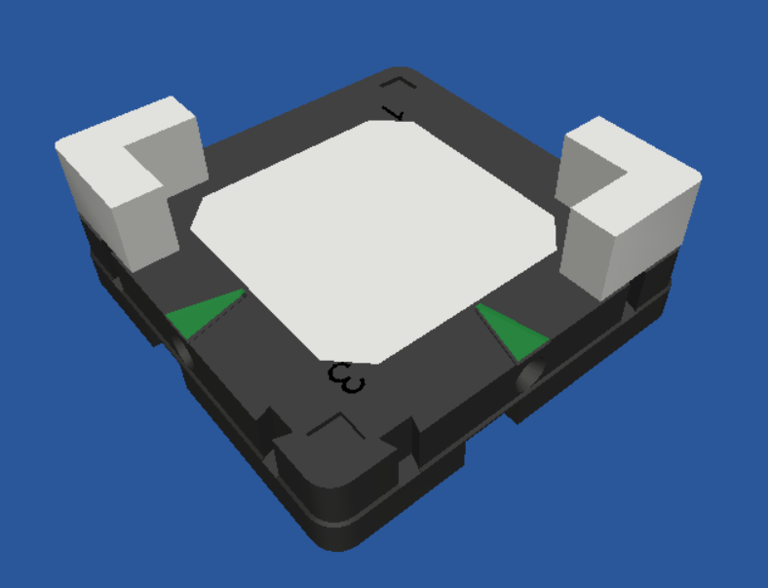
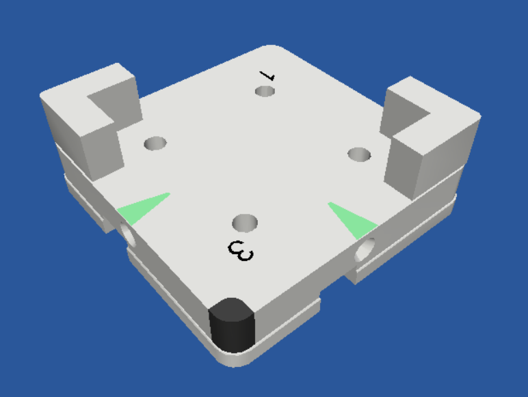
Planned Components from MTpro
Product Evaluation & Planning
WT 1/K
WT 1/S
WT 1/P

Slide 7
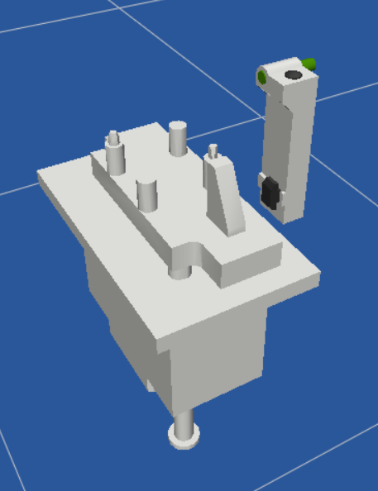
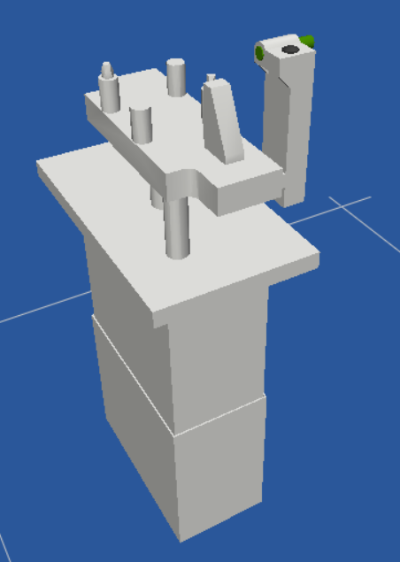
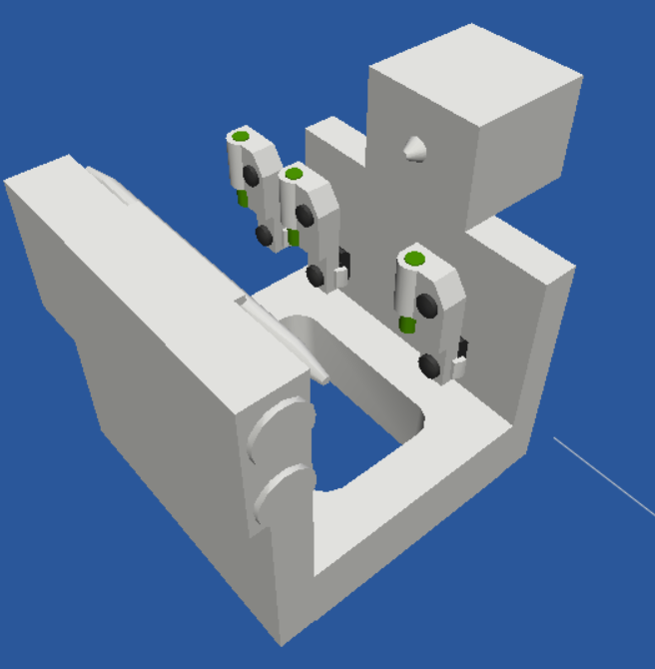
Planned Components from MTpro
Product Evaluation & Planning
PE 1/P
HP 1/P (h=15)
HP 1/P (h=0…50)

Slide 8
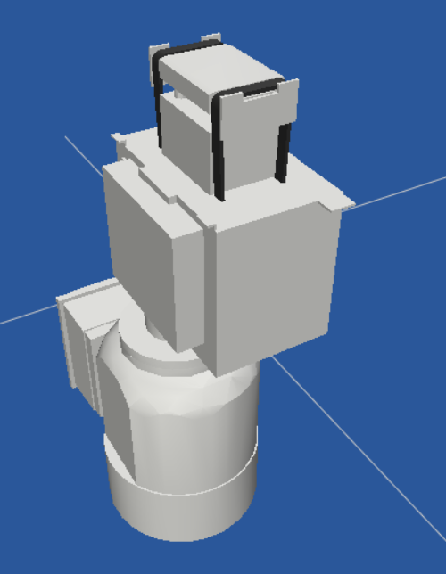
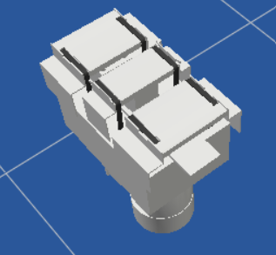
Planned Components from MTpro
Product Evaluation & Planning
HQ 1/U
EQ 1/TR

Slide 9
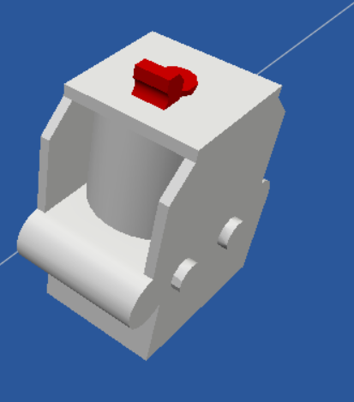
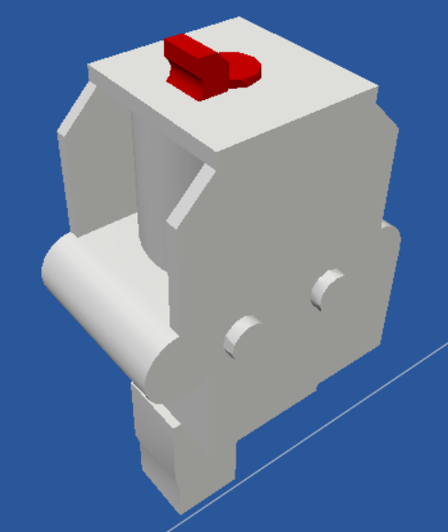
Planned Components from MTpro
Product Evaluation & Planning
VE 1
VE 1/V

Slide 10
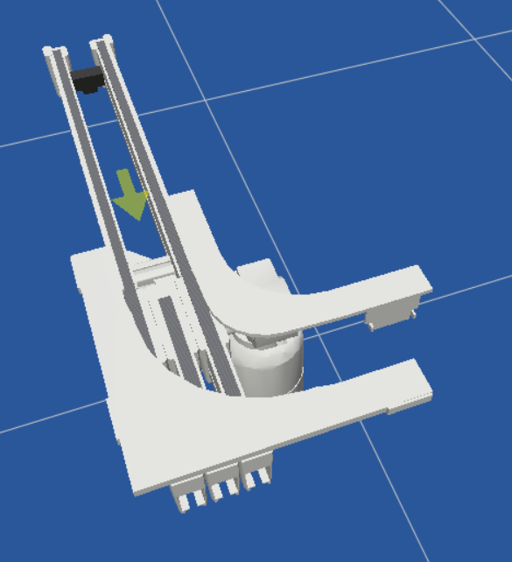
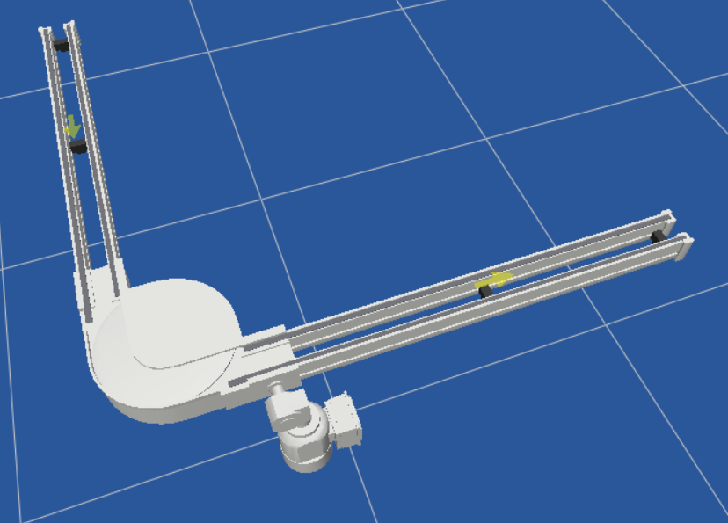
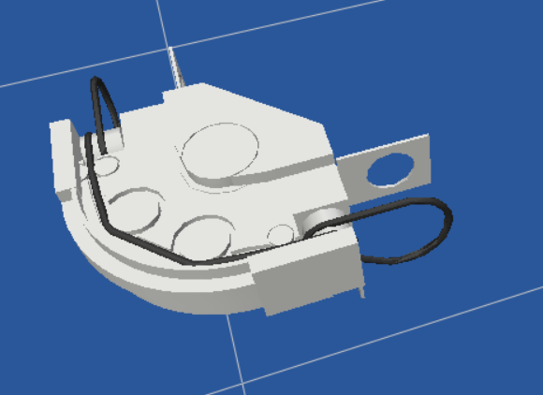
Planned Components from MTpro
Product Evaluation & Planning
CU 1/90
KU 1/90
KU 1/O-90

Slide 11
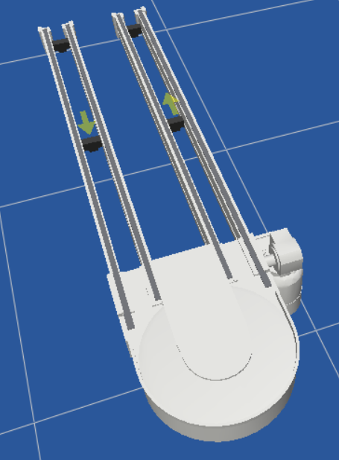
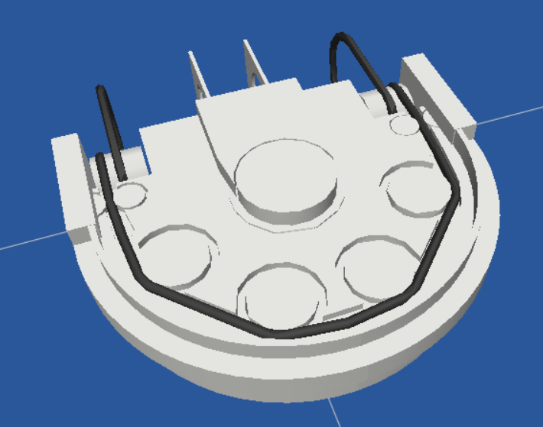
Planned Components from MTpro
Product Evaluation & Planning
KU 1/180
KU 1/O-180

Slide 12
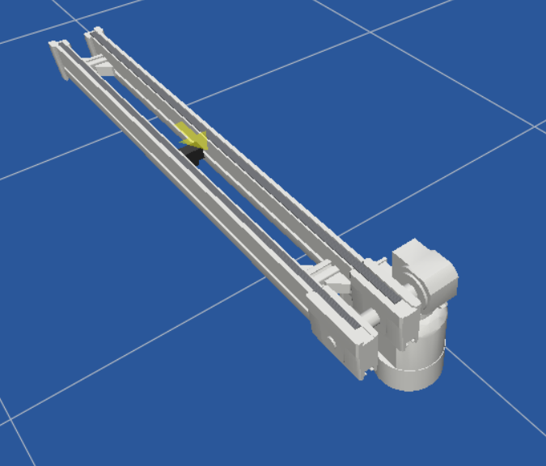
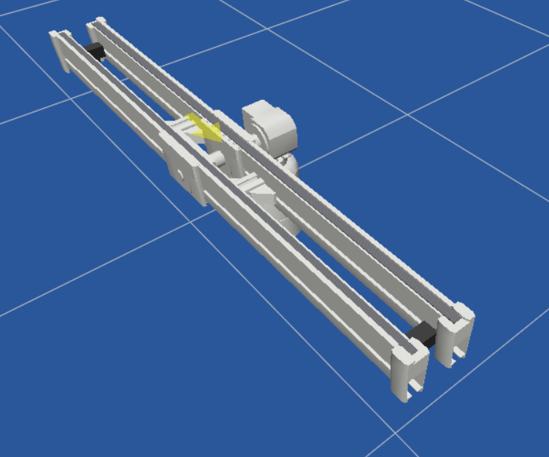
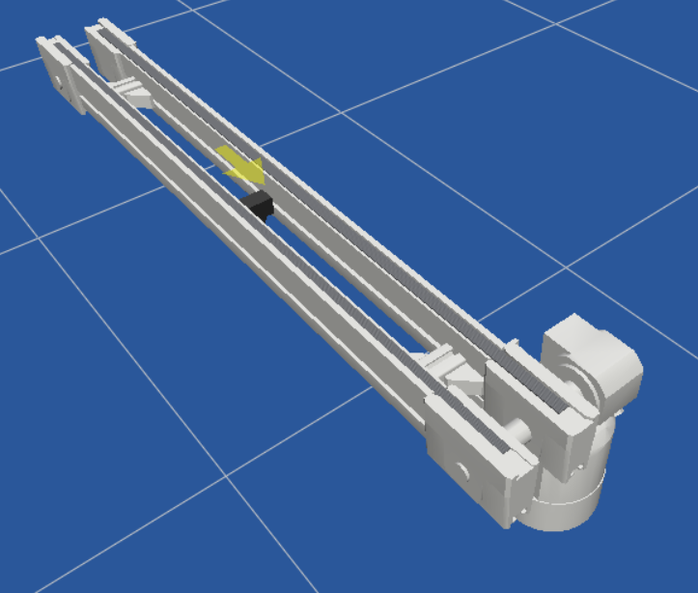
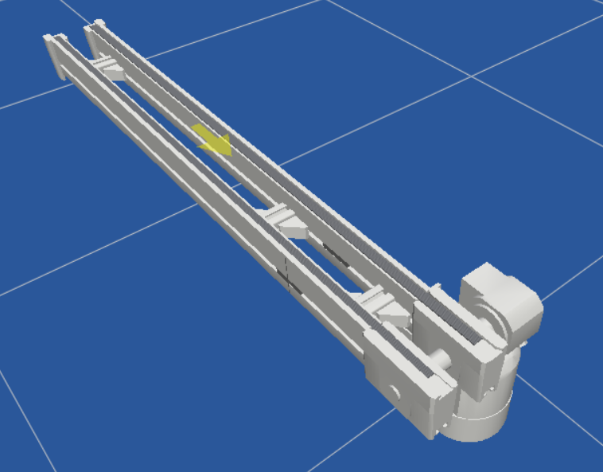
Planned Components from MTpro
Product Evaluation & Planning
BS 1
BS 1/M
BS 1/T
BS 1/S

Slide 13
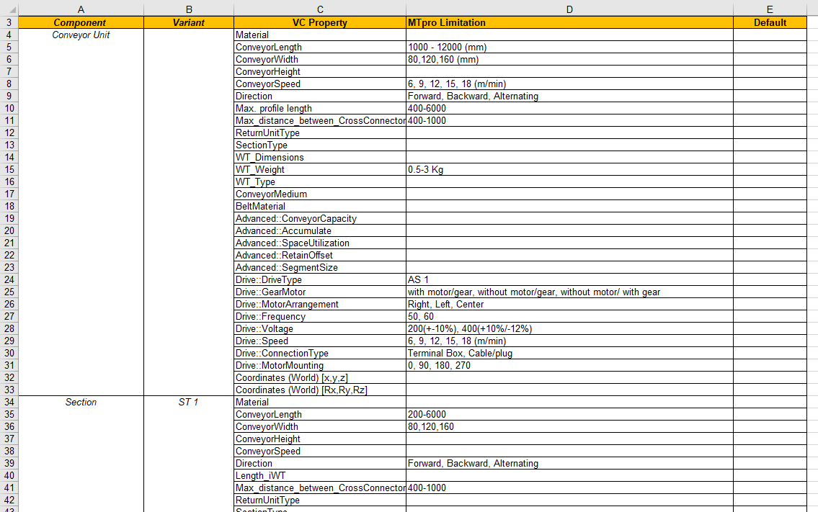
TS1 products properties and limitations
Specifications
MappingTableMTproVC_TS1.xlsx

Slide 14
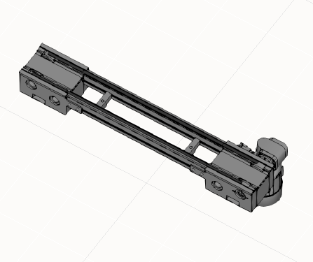
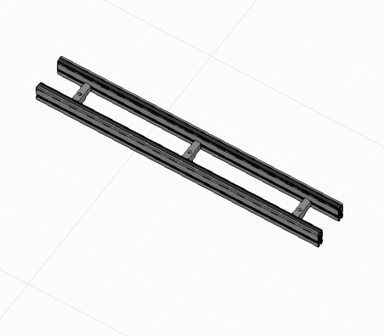
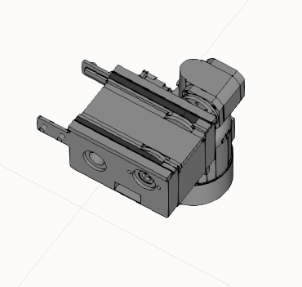
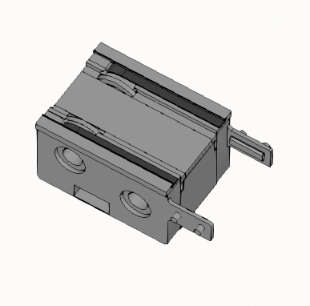
Modelled components
Component Modelling
Conveyor Unit
Section (ST 1)
Drive (AS 1)
Return Unit (UM1)

Slide 15
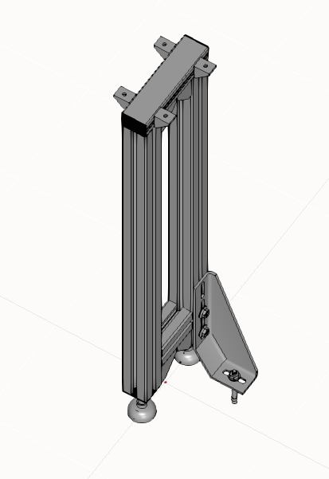
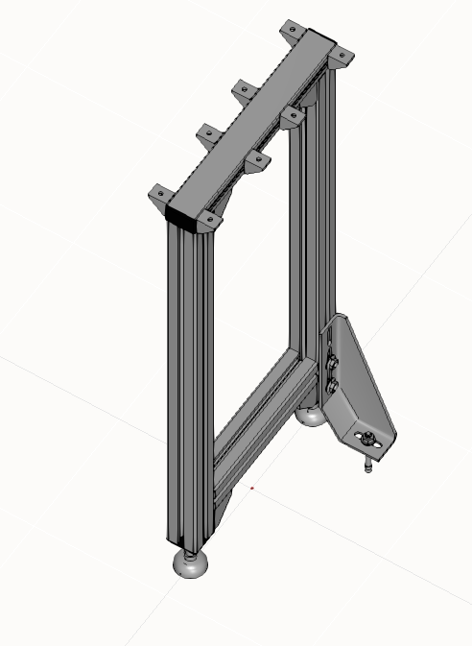
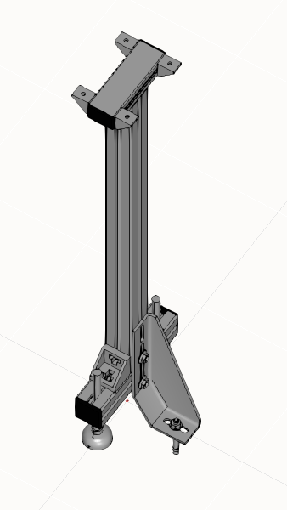
Modelled components
Component Modelling
Legset (SZ 1)
Legset (two tracks)
Legset (SZ 1/L)

Slide 16
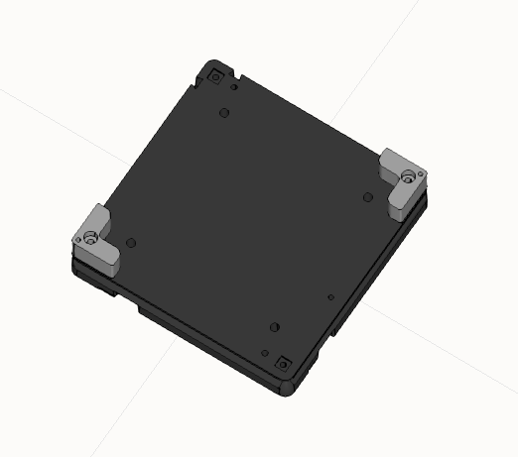
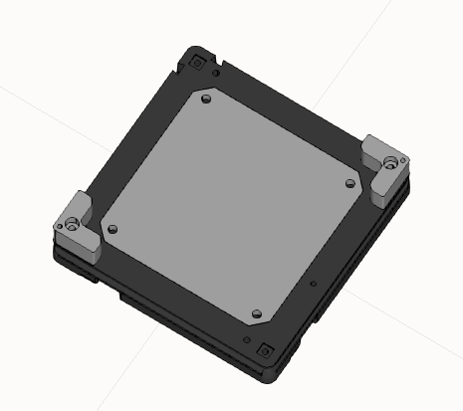
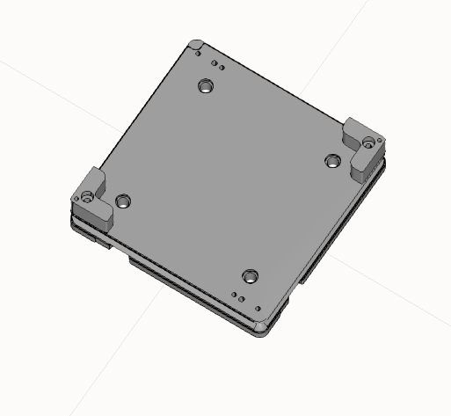
Modelled components
Component Modelling
Workpiece Pallet (WT 1/K)
Workpiece Pallet (WT 1/S)
Workpiece Pallet (WT 1/P)

Slide 17
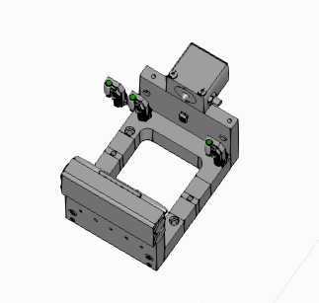
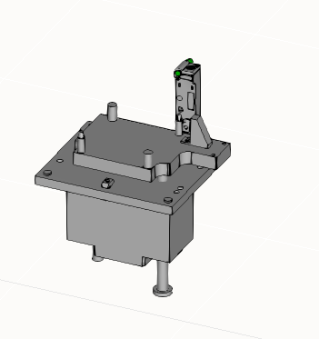
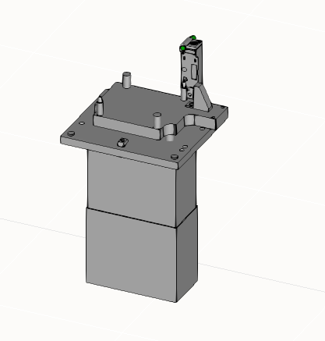
Modelled components
Component Modelling
Position Unit (PE 1)
Lift Position Unit (HP 1/P h=15)
Lift Position Unit (HP 1/P h=0…50)

Slide 18
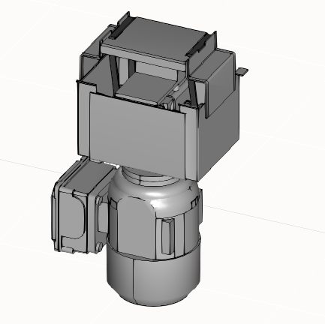
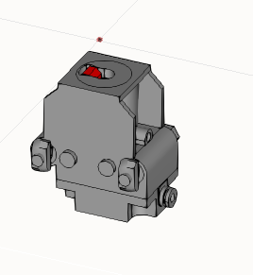
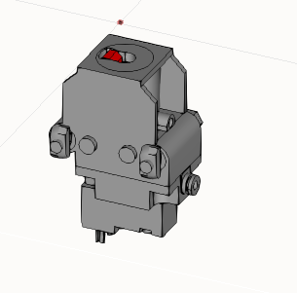
Modelled components
Component Modelling
Lift Transfer Unit (HQ 1/U)
Stop Gate (VE 1)
Stop Gate (VE 1/V)

Slide 19
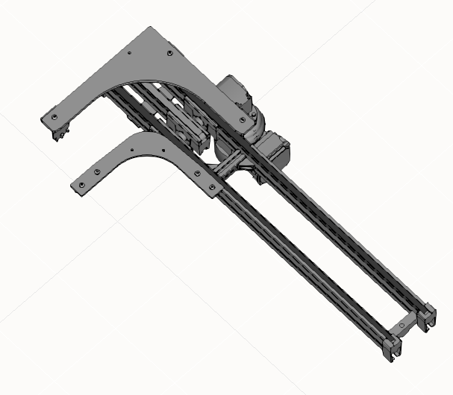
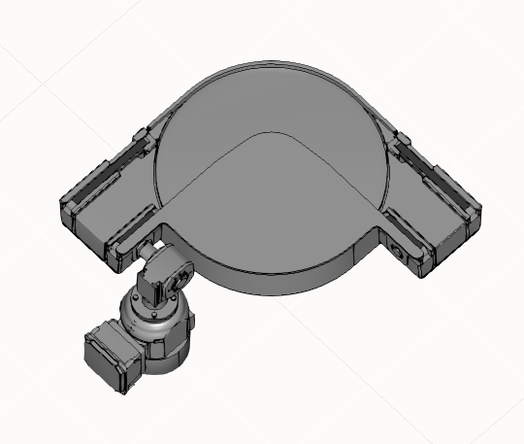

Modelled components
Component Modelling
Curve CU 1/90
Curve KU 1/90
Curve KU 1/90 (KE 1/O-90)

Slide 20


Modelled components
Component Modelling
Curve KU 1/180
Curve KU 1/180
(KE 1/O-180)

Slide 21





Modelled components
Component Modelling
BS 1
BS 1/T
Belt Section
BS 1/M
BS 1/S

Slide 22
Belt Section
Component Modelling
Component | Variant | Status | General Comments
Belt Section | BS 1 | Completed modelling in VC and tested out component properties | Material assigning (excluding belt material) to be modelled.
 | BS 1/M | Completed basic modelling of features and properties Change in motor position yet to be modelled
 | BS 1/T | Completed modelling in VC and tested out component properties
 | BS 1/S | Completed basic modelling of features and properties. Properties and features to be added : No. of segments, Uniform section length toggle, Length of section.

Slide 23
Testing Plan
Testing of TS1 Components
Component Testing
Check if properties and limitations are properly implemented.
Check for proper visualization.
Testing by building Demonstrator Models
Test the basic component behavior.
Test the signals and interfaces or connections.
Testing by building a Complex model
Validate all the components visualization and behavior.

Slide 24
Planned Demonstrator Models
Testing of TS1 Components
Model 1 with conveyor unit, section, return unit, drive, and legset.
Model 2 with lift position unit, position unit and stop gate.
Model 3 with lift transverse unit.
Model 4 with curves and belt sections.

Slide 25




Planned Components
VE 1/D-15
VE 1/20-E
VE 1/D10-E
KU 1/360

Slide 26


Planned Components
EQ 1/T
EQ 1/T-E

Slide 27
Status
Component Modelling
Drive AS1
Workpiece Unit
Section ST1
Drive AS1
Return Unit UM1
Workpiece Unit
Leg Sets
Lift Position Unit
Position Unit
Transverse Conveyor
Stop Gate
Curves
Conveyor Unit
Belt Section
Leg Set SZ1
Return Unit UM1
Section ST 1

